Slide 1
Sprint Review
PDF File Manipulation using PDFtools Library in R

Slide 2
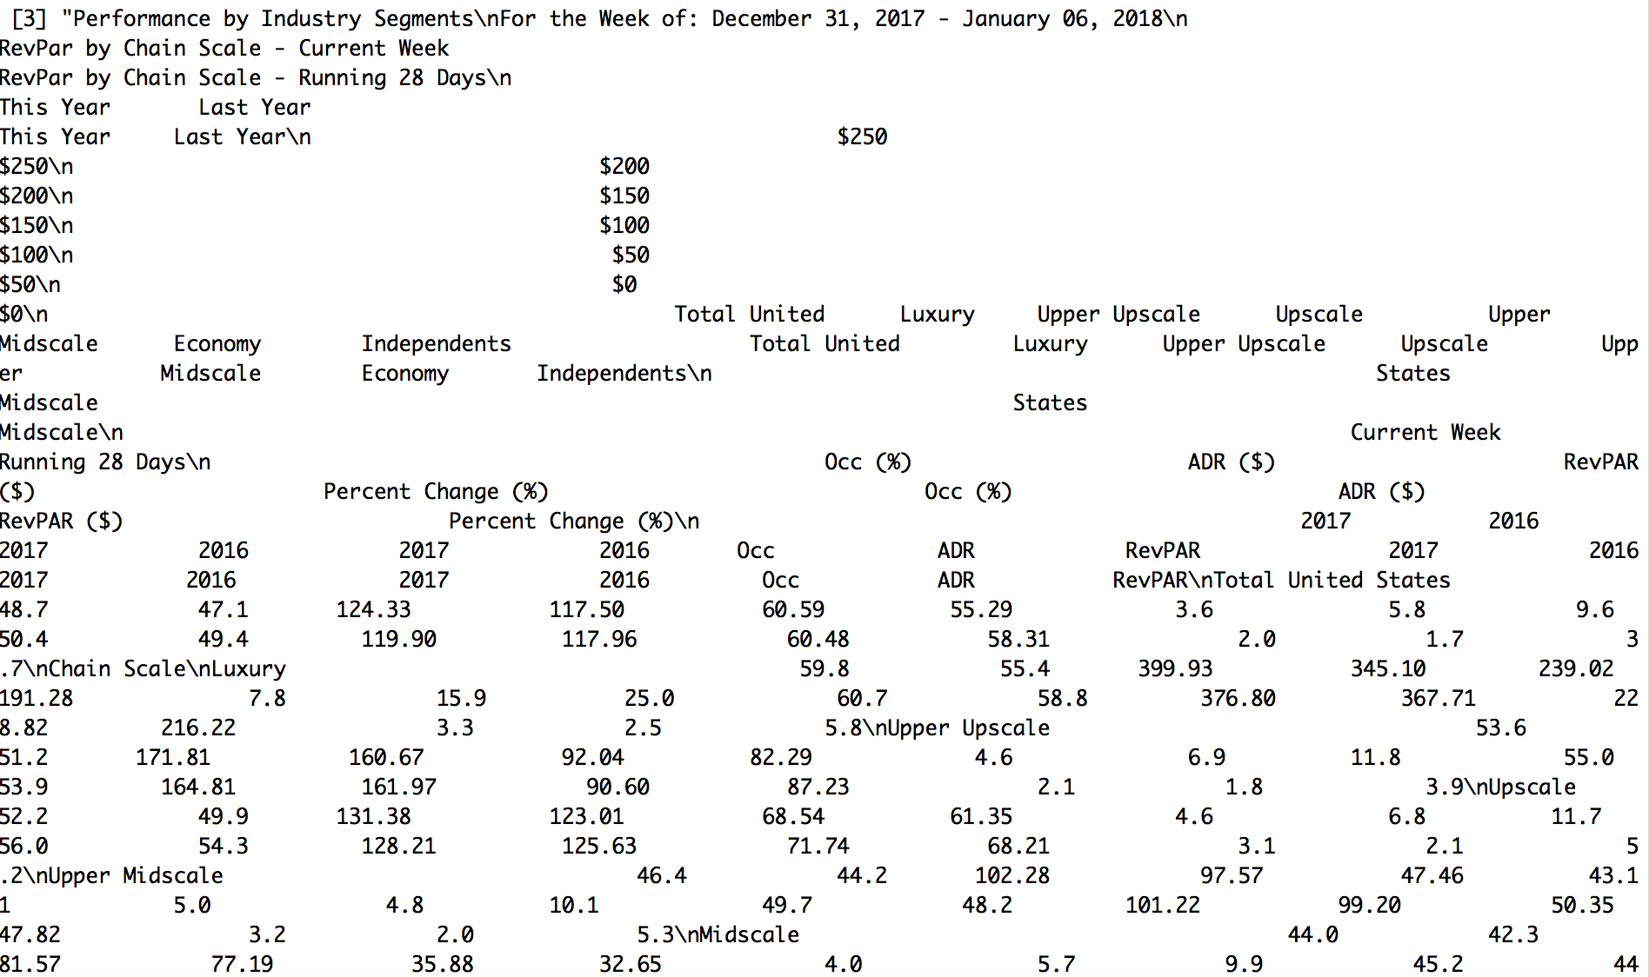
- library(pdftools) - pdfpages <- pdf_text("HotelReview12.31.17.pdf"). - print(pdfpages)

Slide 3
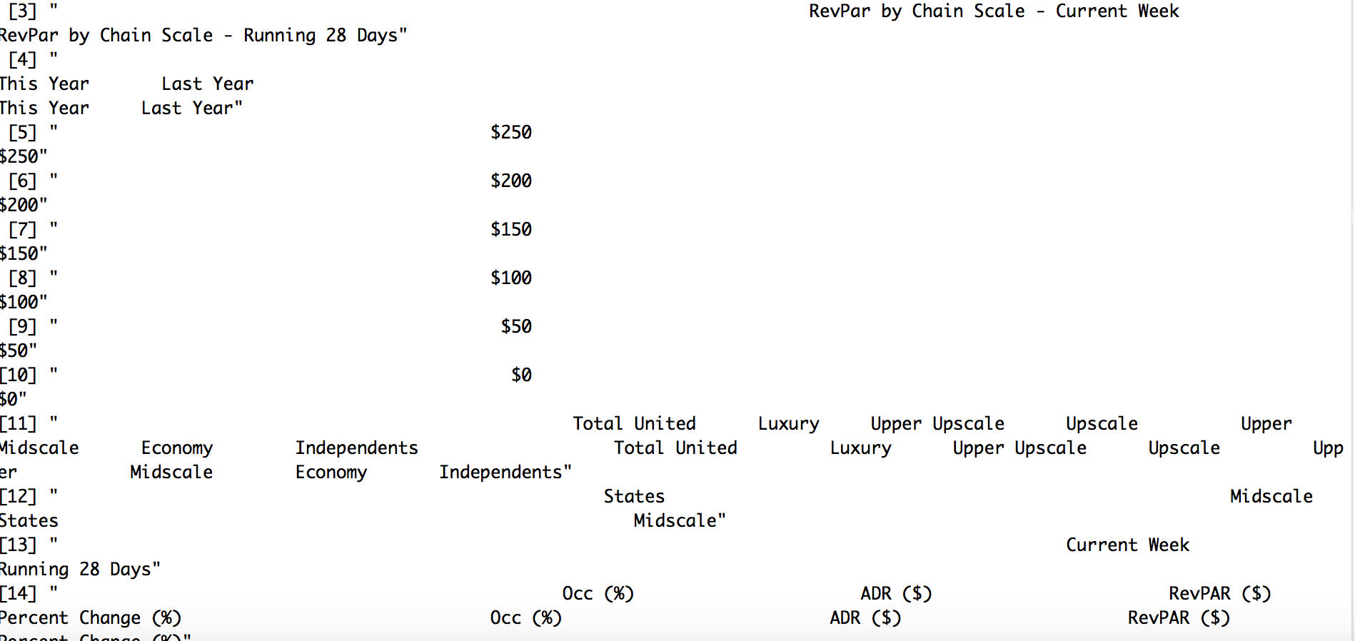
- pagebreaks = strsplit(pdfpages, "\n") -Print(pagebreaks)
NO more “\n”!!!!

Slide 4
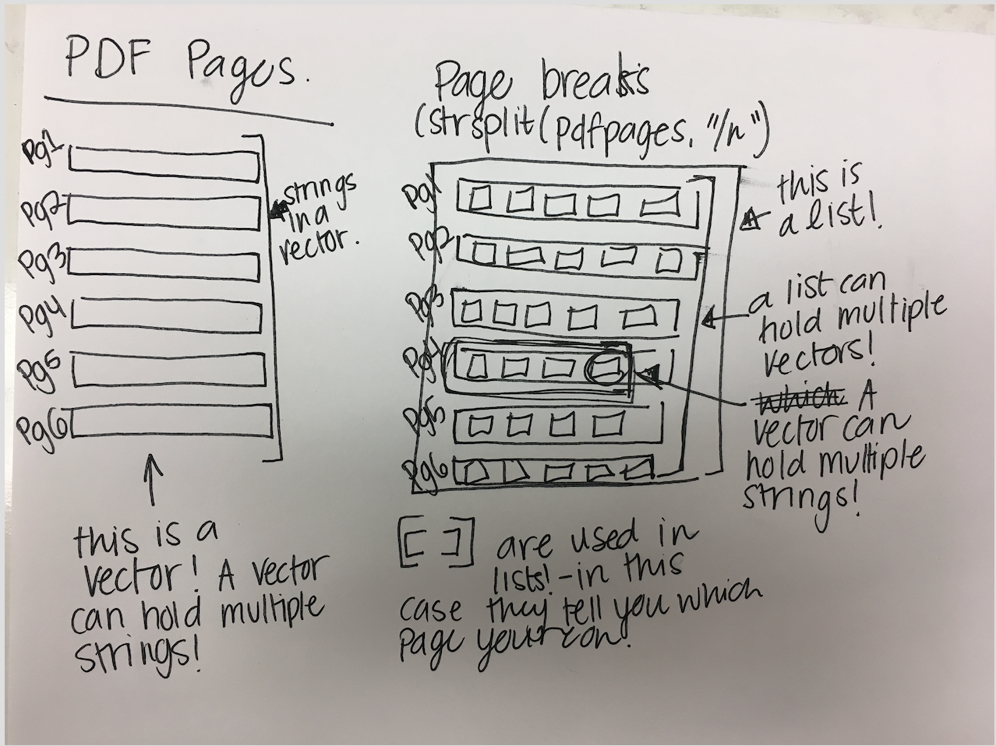
pdfpage3 <- pagebreaks[[3]]
What are the [[double brackets]]?
I’m so glad you asked

Slide 5
Delete all of the lines with no data
datapage = pdfpage3[-(1:10)]
datapage = datapage[-(1:5)]
datapage = datapage[-(2)]
datapage = datapage[-(9)]
datapage = datapage[-(15)]
datapage = datapage[-(21)]
datapage = datapage[-(46:48)]
Efficient?
Maybe not.
… All suggestions welcome

Slide 6
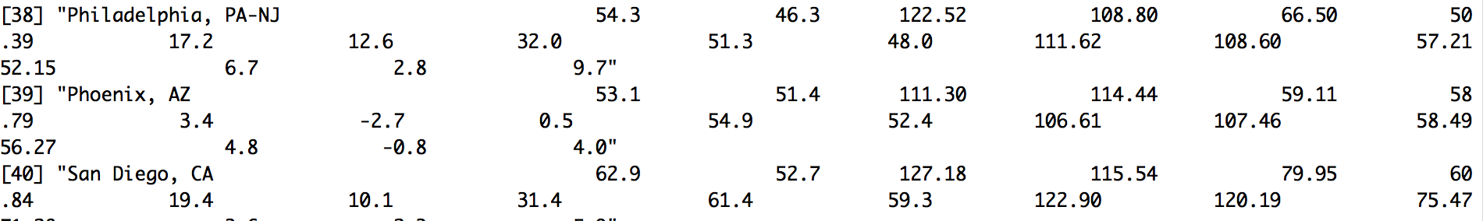
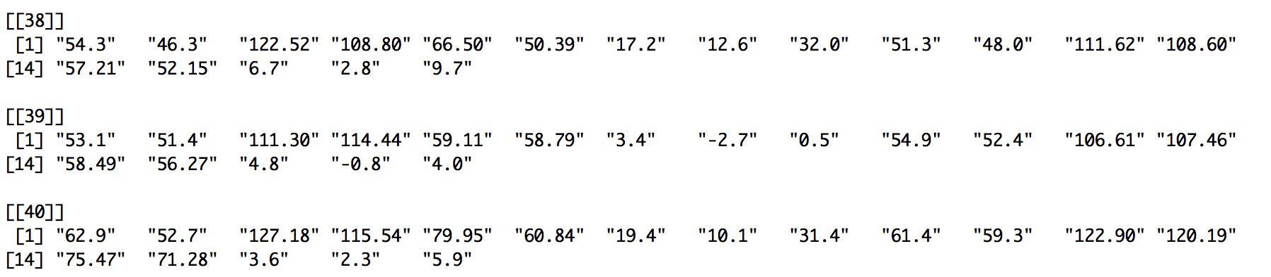
datapage ---- before str_extract_all
datapage = str_extract_all(datapage,"[+-]?([0-9]*[.])?[0-9]+")
Beautiful Organized Strings

Slide 7
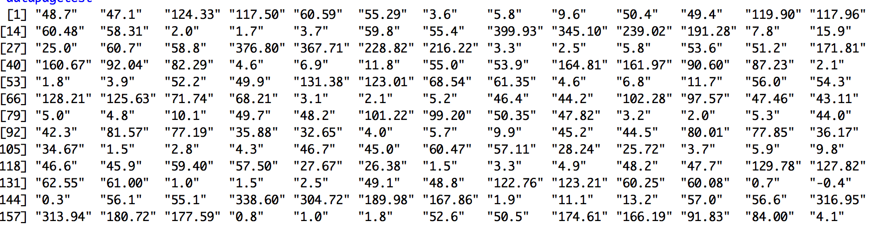
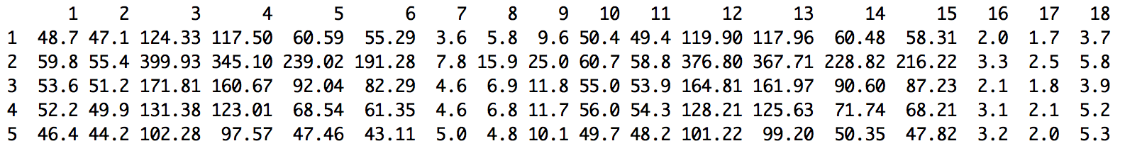
“Unlist()” the data = turns all of the strings into one big string.
Use cbind to create columns in a data.frame!
Hoteldata = cbind.data.frame(split(datapagetest, rep(1:18, times=length(datapagetest)/18)), stringsAsFactors=F)

Slide 8
Name row and columns using
Names() - for columns
row.names() - for rows
AND…..

Slide 9
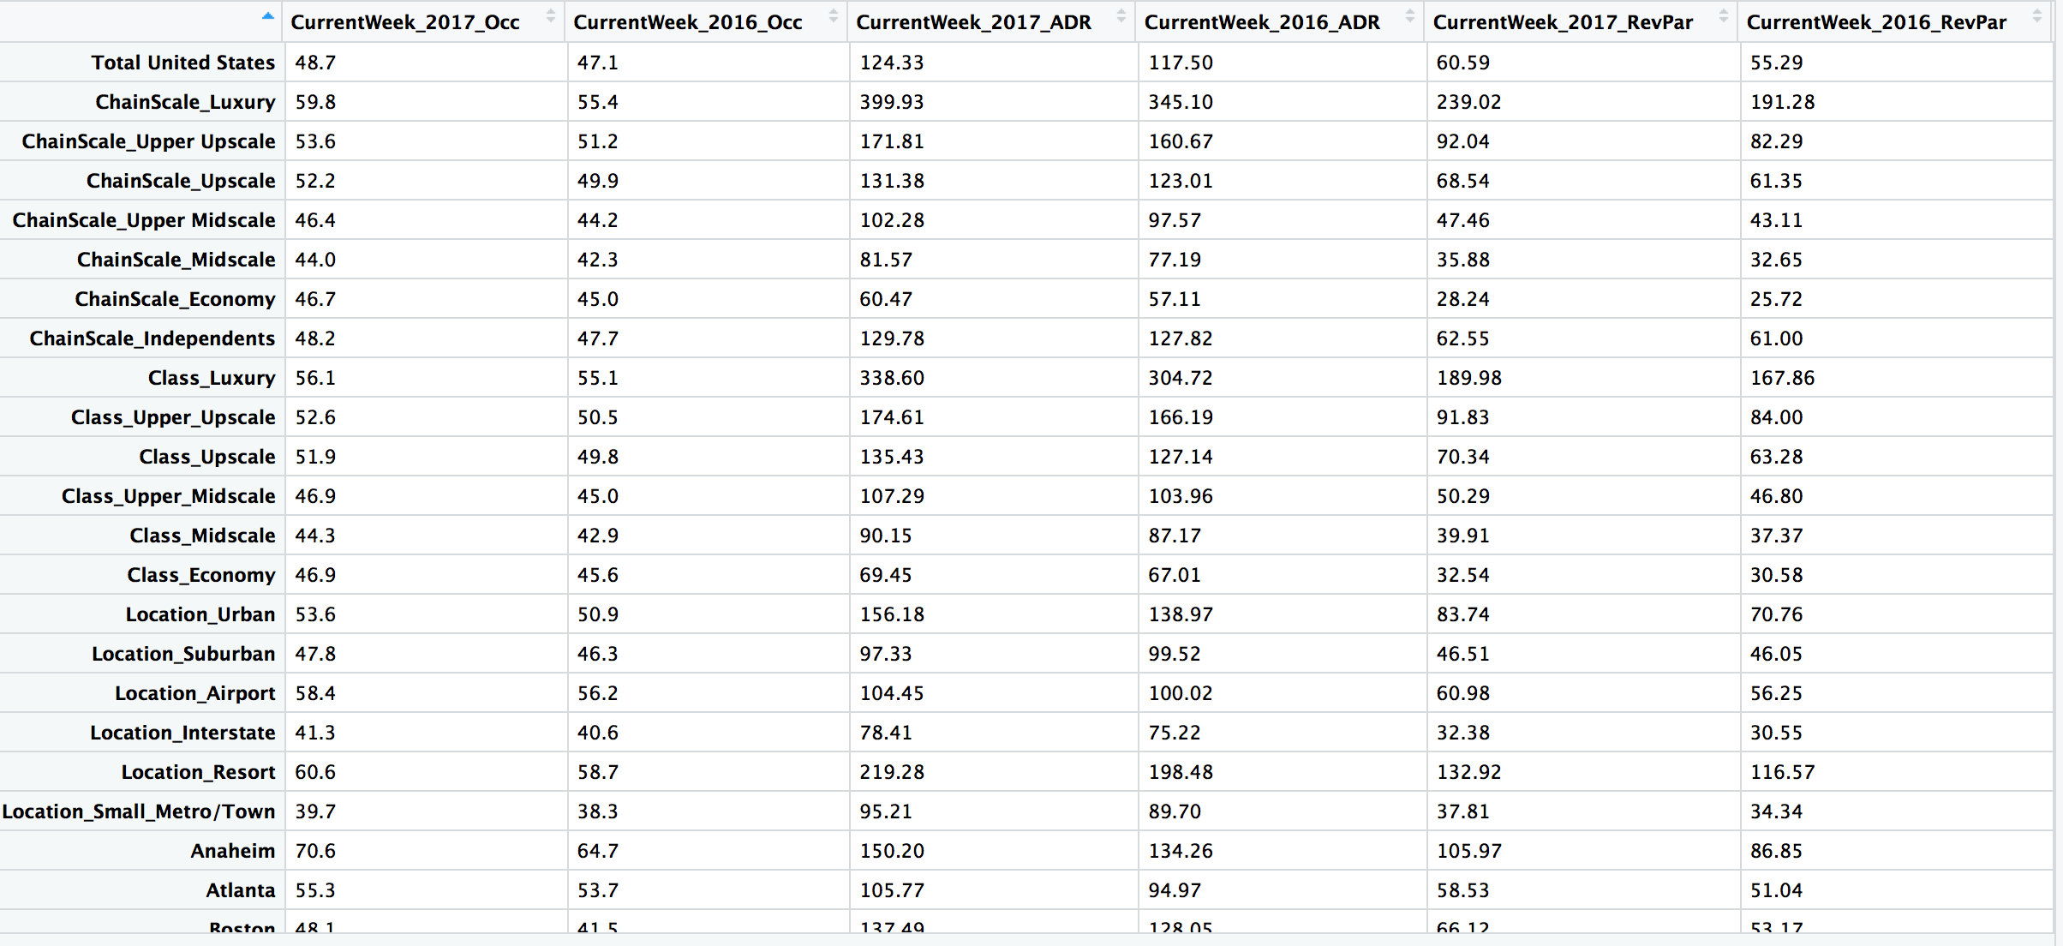
BEHOLD!!!!!

Slide 10
Fin

